Slide 1
ON Ducks & Abstraction
If it quacks like a duck, but needs batteries…
Liskov Substitution Principle

Slide 2
ABOUT ME – Brett carroll
Software developer for eight years
Worked on many different teams
Certified Scrum Master
Worked in Agile (Successful/Challenged) & Waterfall
Worked in ASM to XAML
Cares about Software Engineering
Hobbies:
Family: Wife & 3 dogs
Gisela
Wifi
Proxy
Binary
Grammar Nazi (correct me!)…
… while learning to be nice.

Slide 3
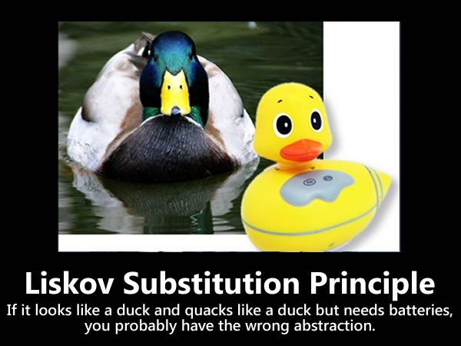
Agenda
Liskov Substitution Principle
What is it?
Where did it come from?
Bertrand Meyer
Barbara Liskov
Robert “Uncle Bob” Martin
Examples
I have brought some from home
Be thinking about other practical examples
Discussion (Q&A)

Slide 4
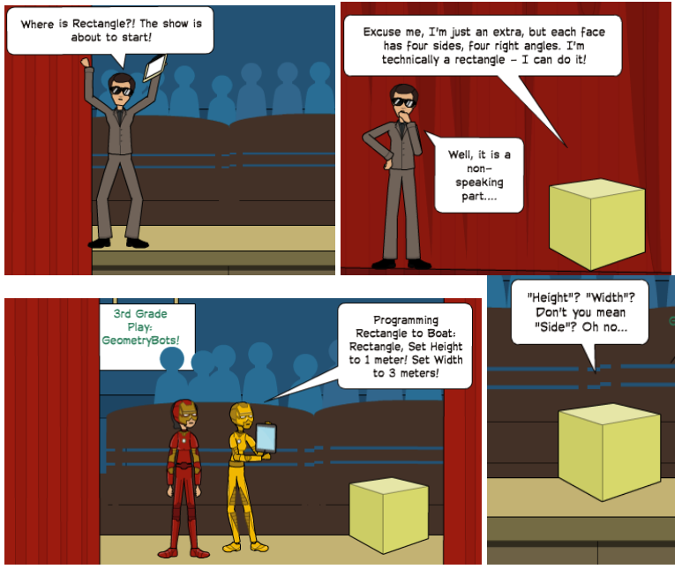
LSp – LisKov Substitution principle
“Let f(x) be a property provable about objects x of type T. Then f(y) should be true for objects y of type S where S is a subtype of T.” – Barbara Liskov
“Derived classes must be substitutable for their base classes.” – Robert Martin
https://www.greatersum.com/solid-series-liskov-substitution-principle/

Slide 5
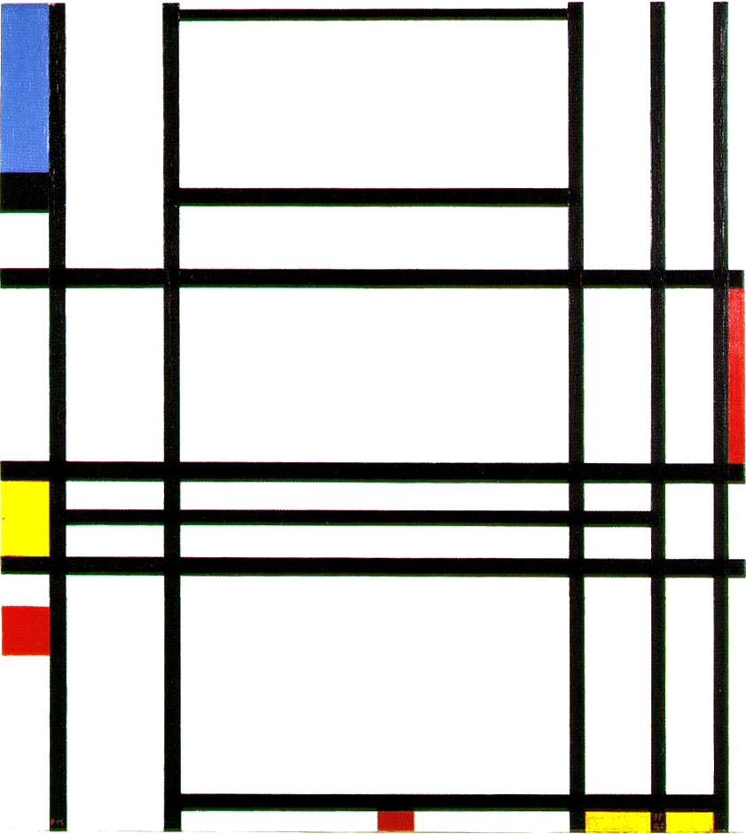
LSp – Practical Definition
“Subtype references should be able to accept the base class without side effects.” – Me (Probably quoting someone, libraryofbabel.info)
“Functions that use pointers of references to base classes must be able to use objects of derived classes without knowing it.” – Robert Martin
What if the subclasses are too different?
What if I need to check the class at runtime?
What if I do get the wrong abstraction?
How will I know I am breaking this rule?

Slide 6
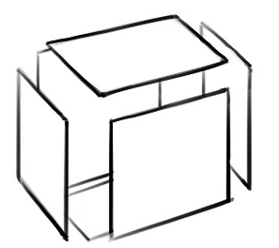

Hoare logic – Crash course
Sir Charles Antony Richard Hoare (Developed Quick Sort)
Formal system of logic rules for reasoning rigorously about the correctness of a program.
{P}C{Q}
Whenever P holds of the state before the execution of C, then Q will hold afterward, or C does not terminate.
Example:
What is a strong P what is a weak Q?
Notes:
Strong P – FALSE – whatever the operation it is consistent with its behavior
Weak Q – TRUE – do nothing a finite amount of times.

Slide 7

Design by Contract – Introduction
Bertrand Meyer (Invented Design By Contract)
Formal Verification – Mathematically verifying computational correctness.
Formal Specification – Mathematically describe the system and software.
Basis of mutual obligations and benefits.
What does the contract expect? What does the contract guarantee? What does the contract maintain?
Notes:
Expect - P
Guarantee –C (or A)
Maintain - Q

Slide 8
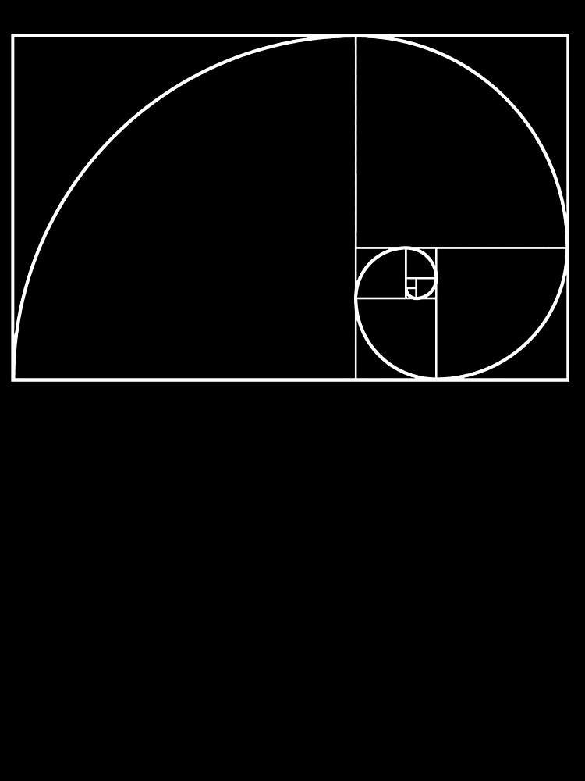
Liskov and wing
Barbara Liskov – For which this principle is named.
Jeannette Wing – Co-author on seminal paper.
Builds on ideas of Hoare, Meyer and others.
Added the idea of reference and pointers to the existing logic and contract principles.
Concerned with specification of subtyping for substitution.
Substitution?

Slide 9
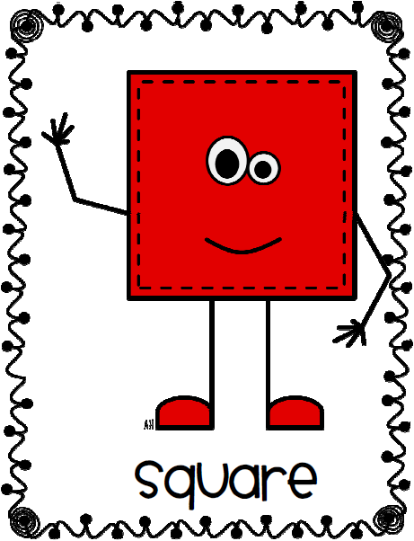
Substitution
Is a Square a Rectangle? We can create very reasonable code that coheres to this idea. But what about when future-me tries to use it?
Behavior: Client – Consumer relationships.
This question has been formalized on Wikipedia: Circle-Ellipse Problem. Is a Circle and Ellipse? Or is it vice versa?
“Inheritance should never be used when the sub-class restricts the freedom implicit in the base class”

Slide 10
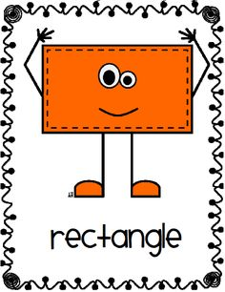
Side effects
What are side effects?
Setting the width and height of rectangle.
Side effects are defined in the contract.
Part of its behavior.

Slide 11
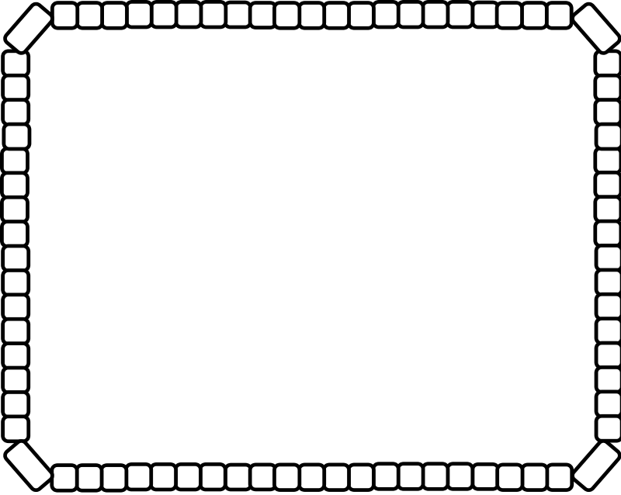
Run time type identification (RTTI)
Using Rectangles at run time.
Rifling a “jagged” list of base types. I.e. Foreach(var thing in bases) { if(thing is DerivedType1) {
thing.DoSomething
} if(thing is DerivedType2)
… }

Slide 12
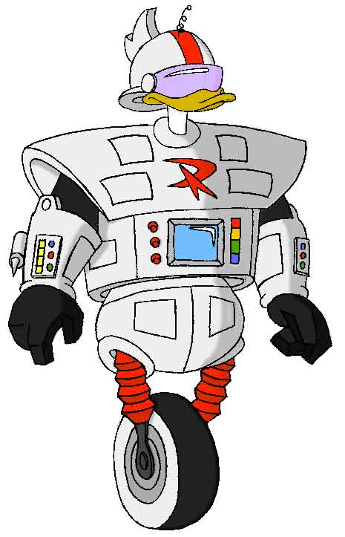

Summary – Is this a duck?

Slide 13
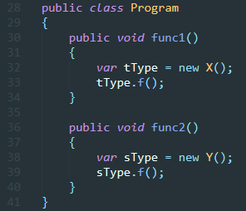
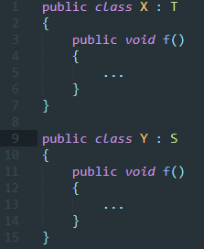
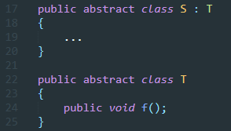
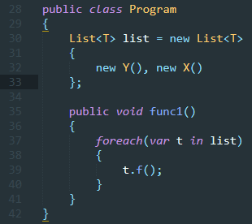
IL-LISK-TRATi-OV

Slide 14
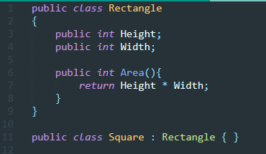
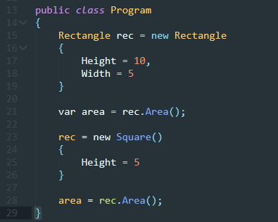
Rectangles – Thinking outside the box.

Slide 15
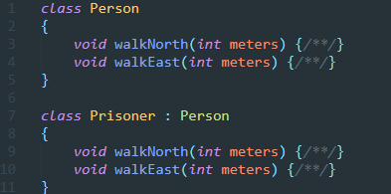
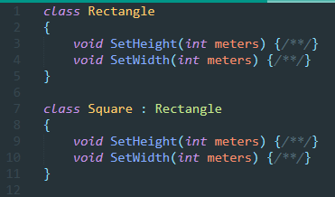
Prisoner dilemma

Slide 16
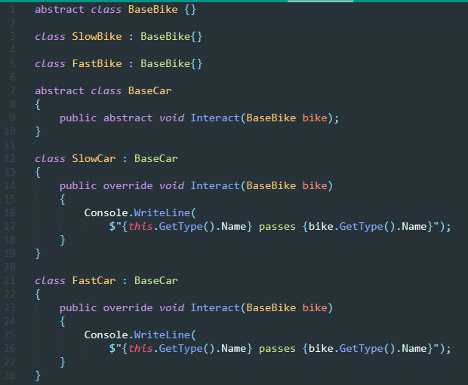
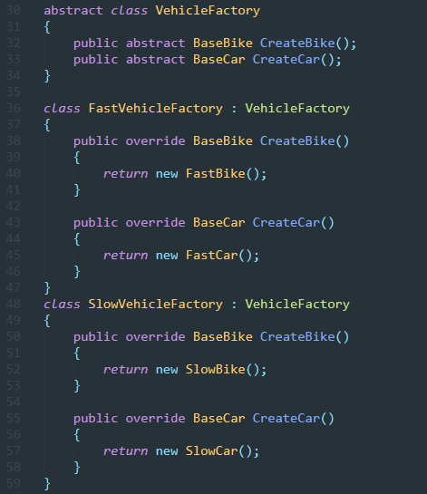
Abstract Factory pattern – the setup

Slide 17
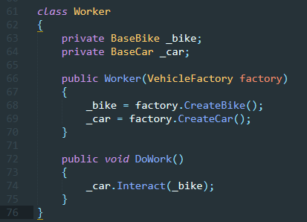
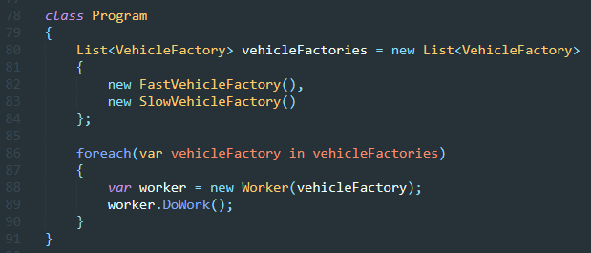
Abstract factory pattern - The work

Slide 18

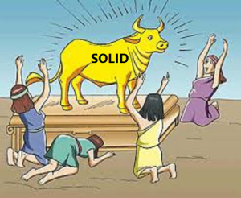
FIN
Q&A

Slide 19
Bib-Liskov-ography
A Behavioral Notion of Subtyping 1994
The Liskov Substitution Principle (Uncle Bob, 1996)
Circle-Ellipse Problem
Object-Oriented Software Construction 2nd Edition (Bertrand Meyer, 1997)

